Slide 1
UNIT -3
SOFTWARE TESTING

Slide 2
CHAPTERS
SIX ESSENTIALS OF SOFTWARE TESTING
STATE OF ART AND STATE OF PRACTICE
CLEAN SHEET APPROACH
ESTABLISHING A PRACTICAL PERSPECTIVES
CRITICAL CHOICES
CRITICAL DISIPLINES
FRAMEWORKS FOR TESTING

Slide 3
SIX ESSENTIALS OF SOFTWARE TESTING
THE QUALITY OF THE TEST PROCESS DETERMINES THE SUCCESS OF THE TEST EFFORT
PREVENT DEFECT MIGRATION BY USING EARLY LIFE-CYCLE TESTING TECHNIQUES
THE TIME FOR SOFTWARE TESTING TOOLS IS NOW
A REAL PERSON MUST TAKE RESPONSIBILITY FOR IMPROVING THE TESTING PROCESS
TESTING IS A PROFESSIONAL DISCIPLINE REQUIRING TRAINED, SKILLED PEOPLE
CULTIVATE A POSITIVE TEAM ATTITUDE OF CREATIVE DESTRUCTION

Slide 4
ESSENTIAL 1 –
THE QUALITY OF THE TEST PROCESS DETERMINES THE SUCCESS OF THE TEST EFFORT
The quality of software system is primarily determined by the quality of software process that produces it.
Testing has its own cycle.
-Begin with product requirement phase and from there entire development process.
Each phase is important testing activity.
Test groups that operate within the organizations having an immature development process will feel more pain than those that don’t.
The test group should focus on improving it’s own internal process.
Immature test will result in unproductive ,chaotic, frustrating environment
produces low quality result and unsatisfactory result.

Slide 5
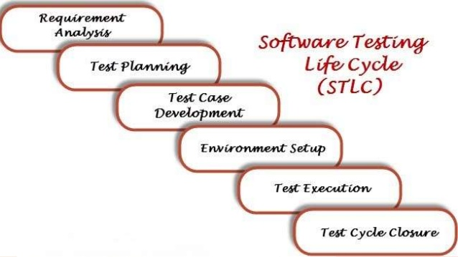

Slide 6
ESSENTIAL 2
PREVENT DEFECT MIGRATION BY USING EARLY LIFE-CYCLE TESTING TECHNIQUES
The cost of the errors is minimized if they are detected in the same phase as they are introduced.
An effective test program prevents the migration of errors from any development phase to any subsequent phases.

Slide 7
ESSENTIAL 3
THE TIME FOR SOFTWARE TESTING TOOLS IS NOW
Wide variety of tools which may have mature and healthy product.
Test-cycle time reductions and automation providing for 24 hours a day of unattended test operations can be achieved with capture and playback tools.
Structural coverage tool is used to determine if the software has been thoroughly tested, this tool tells us specifically which parts of the product have in fact been executed by our tests.
It is no longer acceptable to expect customers to be the first to execute our code.

Slide 8
ESSENTIAL 4
A REAL PERSON MUST TAKE RESPONSIBILITY FOR IMPROVING THE TESTING PROCESS
If the testing group is feeling pain, start campaigning for improvements to a few of the key issues, such as better specifications, better reviews and inspections.
Management should appoint architect or core team to priotize the potential improvements
It is not rocket science but take take time and effort.
Testing tools helps but must be used with in overall testing process.
Software testing is a process that requires people who take responsibility for its improvement.

Slide 9
ESSENTIAL 5
TESTING IS A PROFESSIONAL DISCIPLINE REQUIRING TRAINED, SKILLED PEOPLE
The software testing, process has evolved considerably and has reached the point where it is a discipline requiring trained professionals.
It has become career choice.
It is not entry level job.
When testing is done properly, it surpasses the challenge of product development.

Slide 10
ESSENTIAL 6
CULTIVATE A POSITIVE TEAM ATTITUDE OF CREATIVE DESTRUCTION
Testing require disciplined creativity.
Good testing is that which discover defect in product require real ingenuity, may be view as destructive.
Establishing the proper "test to break" mental attitude has a profound effect on testing success.
Testers make vital positive contributions throughout the development process to ensure the quality of the product

Slide 11
The state of the art and state of the practice
Software testing is yet to become fundamental component of university software engineering curicula
Many well known methods are not used in industry today and development of software system remain inordinately expensive, fraught with costly error
50% of development effort is spent on testing
Many of the people responsible for testing are struggling for viable working platform , available tools in the software development environment.

Slide 12
history
Until 1956 it was the debugging oriented period, where testing was often associated to debugging: there was no clear difference between testing and debugging.
From 1957-1978 there was the demonstration oriented period where debugging and testing was distinguished now - in this period it was shown, that software satisfies the requirements.
The time between 1979-1982 is announced as the destruction oriented period, where the goal was to find errors.

Slide 13
1983-1987 is classified as the evaluation oriented period: intention here is that during the software lifecycle -> product evaluation is provided to measure quality.
From 1988 on it was seen as prevention oriented period where tests were to demonstrate that software satisfies its specification, to detect faults and to prevent faults.

Slide 14
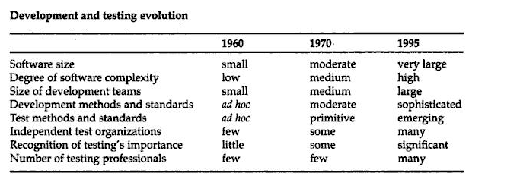

Slide 15
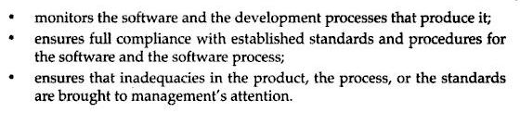
SOFTWARE QUALITY ASSURANCE (SQA) is a set of activities for ensuring quality of software products
Quality assurance defined in the literature as function with

Slide 16
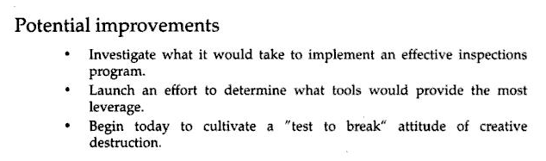
The clean sheet approach to getting started
Start with clean sheet of paper and keep running list of potential improvement are key to renovating the software testing process.
The idea take many forms like
New tools or tool you want to investigate
Fundamental change in software test process

Slide 17
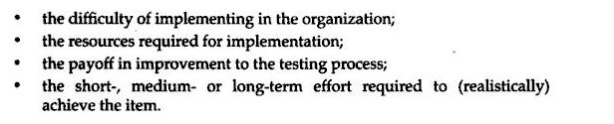
Prioritize improvements the software testing function group.
Identify idea on your sheet as being

Slide 18
Establishing a practical perspective
Software is written by people and people make mistake.
In standard commercial software errors are present.
These errors are expensive
Work to locate them early, especially more critical one.
Implement appropriate testing technique
Testers are not in charge of whole quality program .But quality decision should ultimately based on customer satisfaction.

Slide 19
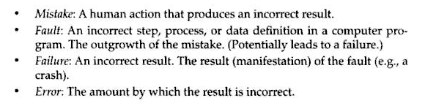

Slide 20
Errors
All error are costly: Undetected as well as error detected late in the software development process are most expensive
Undetected error migrate downstream within system to cause failure.
If it is detected only after later stages of the development they became costly to rework.
If not detected cause failure.

Slide 21
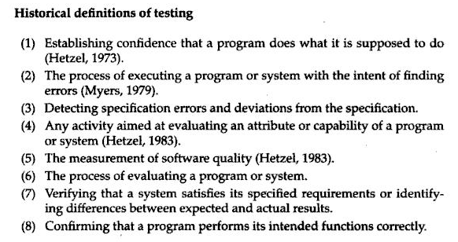
What is testing really? Some definition

Slide 22
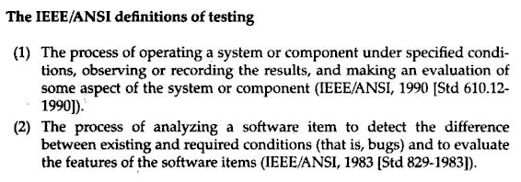
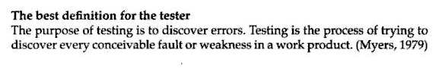

Slide 23
dfhf
Testers hunt errors
If the tester job is to find every error or fault or weakness in the work product, then good test is one that has good probability of detecting undiscovered error and successful test is one that detect undiscovered error.
The focus on showing the presence of error is basic attitude of good tester.
Detected error are celebrated for the good of the product
It gives personal satisfaction , we feel good if we find defects.

Slide 24
Testers are destructive- but creatively so
Testing is positive and creative effort of destruction .
It take imagination persistence and strong sense of mission to systematically locate the weakness in complex structure and to demonstrate its failure.
Testers pursue error not people
Error are in the work product , not in the person who made mistake.
With the test to destroy attitude we are not attacking individual in the organization or team but looking for error in the developed work product.
The key to manage the developer and tester as team.
Testers add value
Testers add value to product by discovering error and getting them on table as early as possible

Slide 25
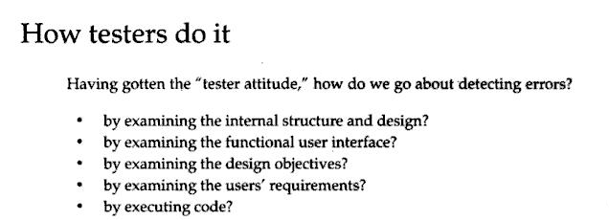

Slide 26
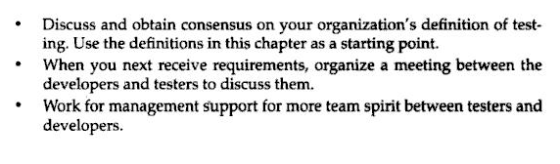
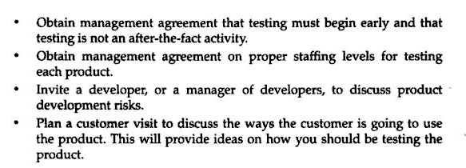
Suggestion for clean sheet approach:

Slide 27
CHAPTER 5
CRITICAL CHOICES: what when and how to test

Slide 28
RISK AND RISK MANAGEMENT
START TESTING EARLY
BASIC FORMS OF TESTING PROCESS
TESTING,THE DEVELOPMENT CYCLE,REAL WORLD OF CONTACTS
EFFECTIVE TESTING AND COST EFFECTIVE TESTING

Slide 29
Introduction
Exhaustive testing mean that product never reach the market because testing would never be completed.
Fifty percent or more time of developmental organization is spent on error detection and removal.
One choice is test the right things- ensure more critical items are tested don’t waste resource on less important items.
Test early: Prevent costly migration
Testing life cycle include verification testing and validation testing

Slide 30
Critical items are tested not waste resource on limited resources , error are closure to the phase where they are introduced
Costly migration of error downstream.

Slide 31
Risk and risk management

Slide 32
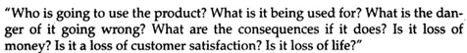
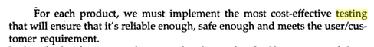

Slide 33
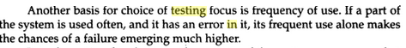

Slide 34
Risk in system as a basis for testing choices

Slide 35
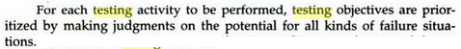

Slide 36
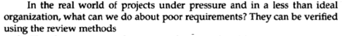
Start testing early

Slide 37
BASIC FORMS OF TESTING:
Verification
validation

Slide 38
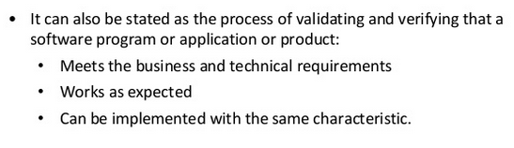

Slide 39
1.1 Verification and Validation Basic Concepts
Verification "Are we building the product right”
The software should conform to its specification
Validation "Are we building the right product”
The software should do what the user really requires.
i.e. is the customer need (requirements ) met?

Slide 40
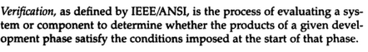
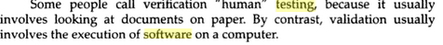

Slide 41
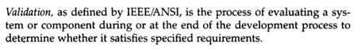
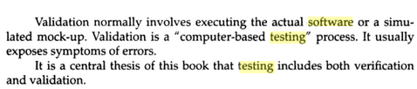

Slide 42
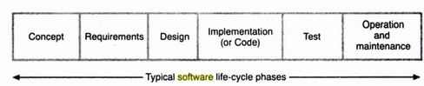
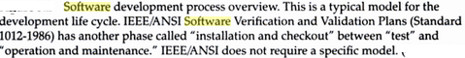
TESTING,THE DEVELOPMENT CYCLE,REAL WORLD OF CONTACTS

Slide 43
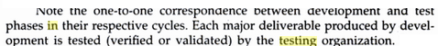
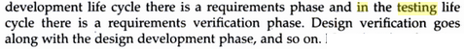

Slide 44
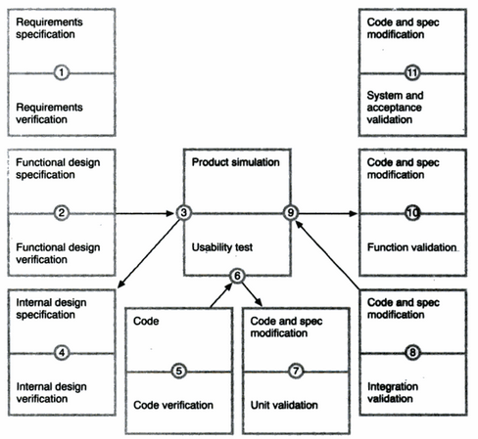

Slide 45
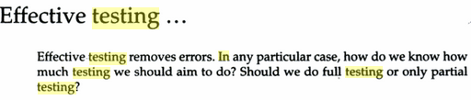

Slide 46
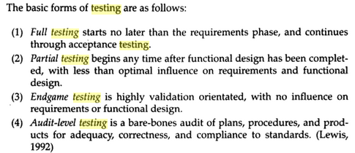

Slide 47
Critical software is software whose failure cold have impact on safety, or could cause large financial or social loss.

Slide 48
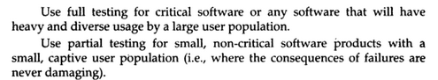
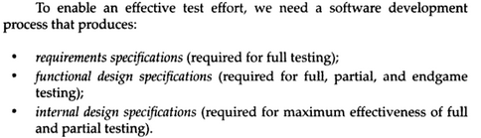

Slide 49
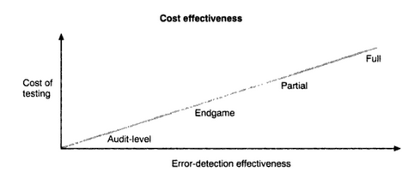
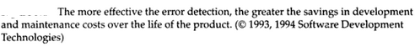

Slide 50
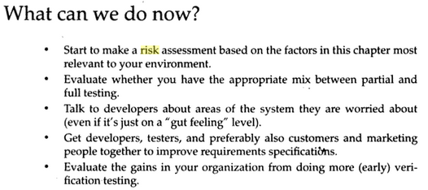

Slide 51
Chapter 6 Critical disciplines: Framework for testing
Planning
Considerations in verification planning
Considerations in verification planning
Software Engineering Maturity and SEI Process Maturity levels:
How process maturity level affects testing
Configuration Management
Testing Interest in configuration management

Slide 52
Standards
IEEE/ANSI Standards
Formal documents
Measurement
Tools

Slide 53
Planning
First step of activity
Review requirements before testing
Improve specification by good testing.
What kind of standards are going to useful?
Inspections and reviews?

Slide 54
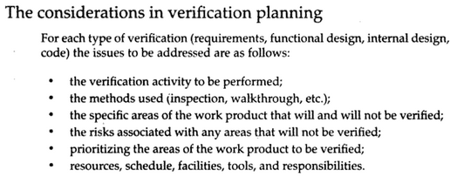

Slide 55
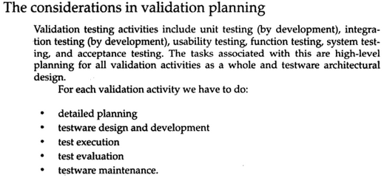

Slide 56
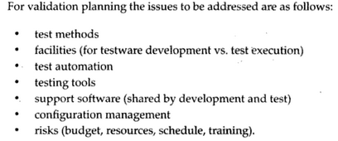

Slide 57
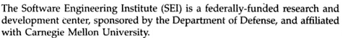
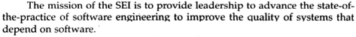
Software engineering maturity and SEI

Slide 58
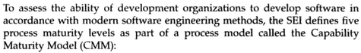
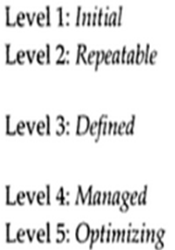
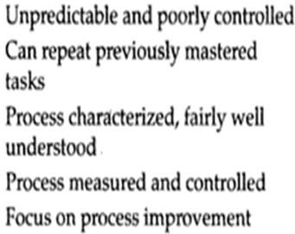

Slide 61
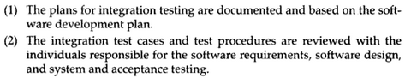
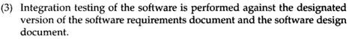

Slide 62
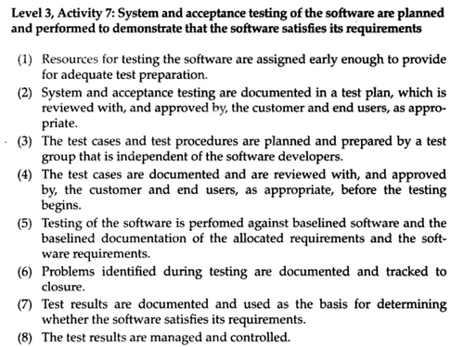

Slide 63
How process maturity affects testing
amount of testing budget spent on non technical issues is inverse proportional to maturity level within environment as a whole.
Level 1: uncertainty outcome is unpredictable
SPA :software process assessment-special consultancy service.
Evaluating s/w process maturity

Slide 64
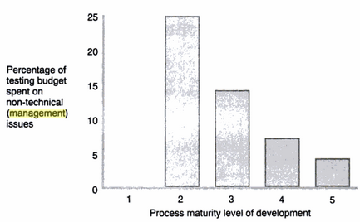
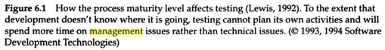

Slide 65
Configuration management (CM) is a systems engineering process for establishing and maintaining consistency of a product's performance, functional, and physical attributes with its requirements, design, and operational information throughout its life.

Slide 66
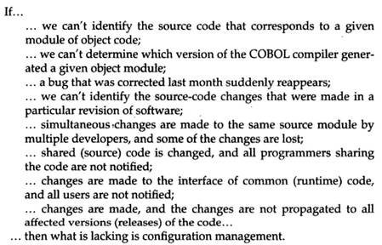

Slide 67
Configuration management (CM) is a systems engineering process for establishing and maintaining consistency of a product's performance, functional, and physical attributes with its requirements, design, and operational information throughout its life.

Slide 68
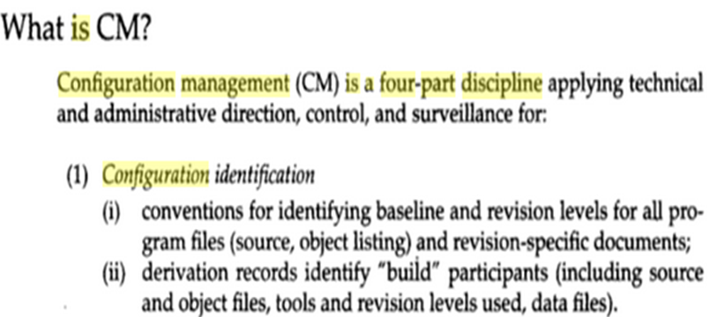

Slide 69
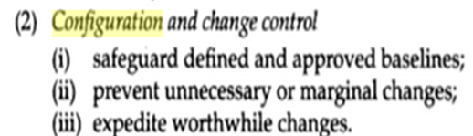

Slide 70



Slide 71


Slide 72


Slide 73

Testing Interest in CM

Slide 74


Slide 75


Slide 76



Slide 77


Slide 78


Slide 79

Formal document is document of which the form , general content and timing has been agreed in advance. It is deliverable.
It is document in order to put decision in writing.
Document is vehicle for stake holder communication.
Document are delivered by the development and testing group.

Slide 80


Slide 81


Slide 82

Measurement

Slide 83
Measurement and tracking incident reports
Provides a leading indicators of product quality
Provides significant criteria for readiness
Correlates to user satisfaction with product
Serves predictor for remaining error
Provide measure of product quality relative to other product
Provide measure of testing efficiency

Slide 84


Slide 85

TOOLS

Slide 86


Slide 87


Slide 88


Slide 89


Slide 91


Slide 93
Testing Interest in CM

Slide 95


Slide 102
Internal design specification : insist that development produce an internal design specification.

Slide 103
Testware

